Slide 1
Leaders, Invest In Your Wellth
By Evie King, MRT

Slide 2
You are not here merely to make a living. You are here in order to enable the world to live more amply, with greater vision, with a finer spirit of hope and achievement. You are here to enrich the world, and you impoverish yourself if you forget the errand.
- President Woodrow Wilson

Slide 3
Wealth
noun | \welth\ Derived from the Middle English, welthe : meaning wellbeing and happiness : a large amount of money and possessions
Wellth
noun | \welth\ life currency : a life exemplified by abundance, happiness, purpose, health, and joy
http://wellth.mindbodygreen.com/

Slide 4
Personal Wellth Assessment

Slide 5
Low Wellth Will:
Decrease Productivity
Increase errors
Disengage from purpose
Increase Mental Blocks
Create a negative atmosphere
High Wellth Will:
Increase curiosity & creativity
Improve focus & productivity
Foster a healthy environment
Increase confidence

Slide 6
How do you take care of yourself when you’re already so busy?
Giphy

Slide 7
Wheel of Wellth

Slide 8
Hunt the Good Stuff w/ Team
Easy Ways to Invest in Your Wellth
Outsource
Update your workspace
Restoration Break – quick walk, lunch away from desk
One-Night-A-Week
BREATHE

Slide 9
Health Benefits of Deep Breathing
Calms the nervous system
Releases muscle tension
Improves digestion
Increases clarity

Slide 10
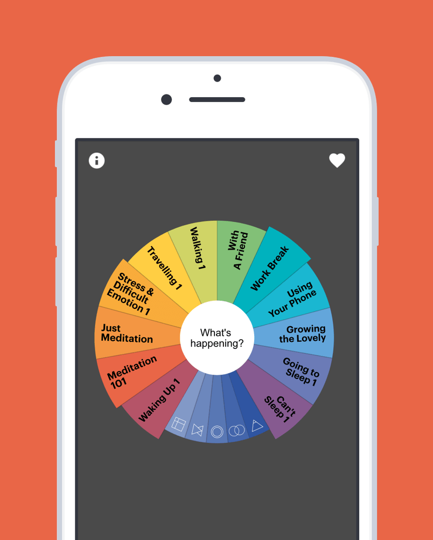
Next steps:
Pick 1 day
Remove 1 thing
Have conversation with someone you trust
Breath trigger or routine
Recommendations:
168 Hours: You Have More Time Than You Think by Laura Vanderkam
Buddhify App ($3-$5)

Slide 11
Contact Info:
evie@in-dependent.org
www.in-dependent.org
@independentorg

